Slide 1

SILVER OAK COLLEGE OF COMPUTER APPLICATION
SUBJECT :Programming in Python
TOPIC : Python Data Structures, Functions and Exception Handling

Slide 2
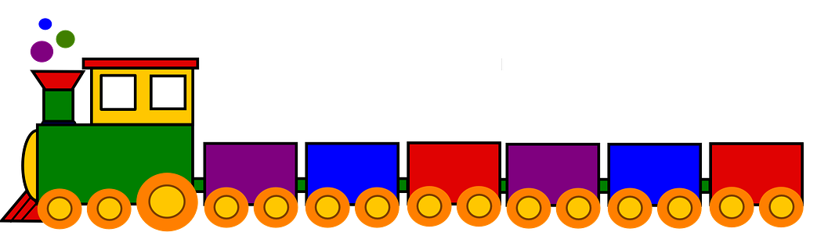
Programming with Python
T
U
P
L
E
S
L
I
S
T
S
2
Programming

Slide 3
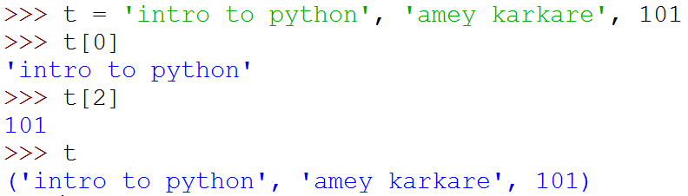
Tuples
A tuple consists of a number of values separated by commas
Empty and Singleton Tuples

Slide 4
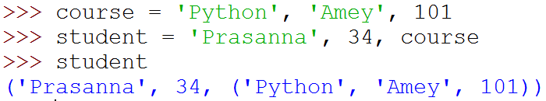

Nested Tuples
Tuples can be nested
Note that course tuple is copied into student.
Changing course does not affect student

Slide 5
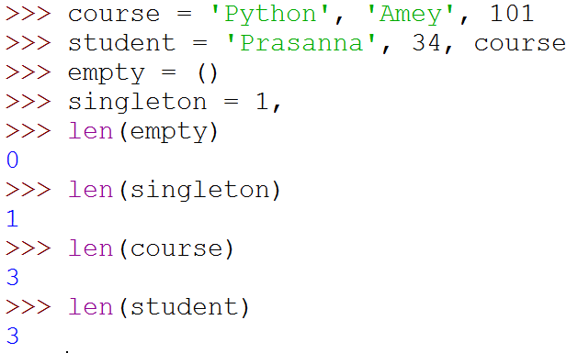
Length of a Tuple
len function gives the length of a tuple

Slide 6
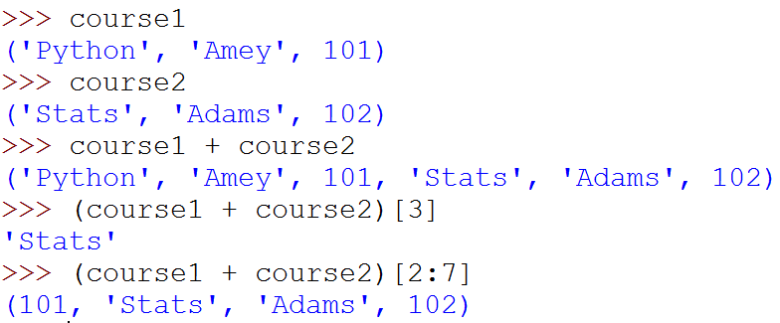
More Operations on Tuples
Tuples can be concatenated, repeated, indexed and sliced

Slide 7
Unpacking Sequences
Strings and Tuples are examples of sequences
Indexing, slicing, concatenation, repetition operations applicable on sequences
Sequence Unpacking operation can be applied to sequences to get the components
Multiple assignment statement
LHS and RHS must have equal length

Slide 8
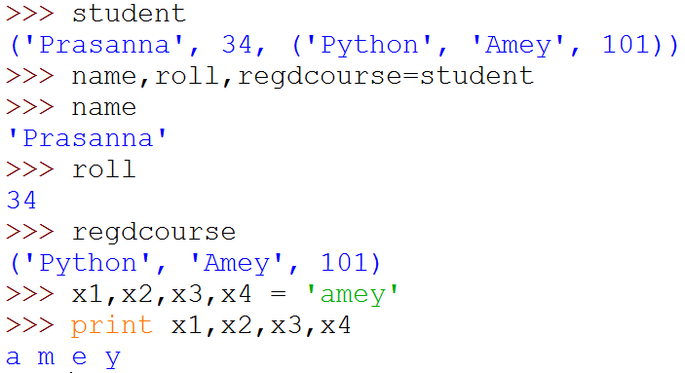
Unpacking Sequences
(
)

Slide 9
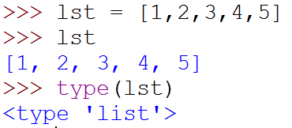
Lists
Ordered sequence of values
Written as a sequence of comma-separated values between square brackets
Values can be of different types
usually the items all have the same type

Slide 10
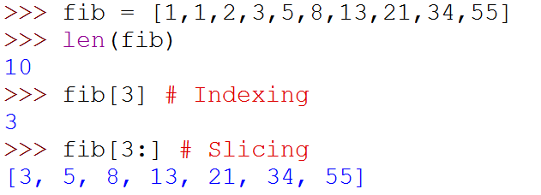
Lists
List is also a sequence type
Sequence operations are applicable

Slide 11
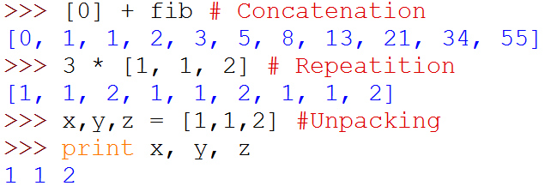
Lists
List is also a sequence type
Sequence operations are applicable
Repetition
(
)

Slide 12
More Operations on Lists
L.append(x)
L.extend(seq)
L.insert(i, x)
L.remove(x)
L.pop(i)
L.pop()
L.index(x)
L.count(x)
L.sort()
L.reverse()
x is any value, seq is a sequence value (list, string, tuple, …),
i is an integer value

Slide 13
Mutable and Immutable Types
Tuples and List types look very similar
However, there is one major difference: Lists are mutable
Contents of a list can be modified
Tuples and Strings are immutable
Contents can not be modified

Slide 14
Summary of Sequences
Operation | Meaning
seq[i] | i-th element of the sequence
len(seq) | Length of the sequence
seq1 + seq2 | Concatenate the two sequences
num*seq seq*num | Repeat seq num times
seq[start:end] | slice starting from start, and ending at end-1
e in seq | True if e is present is seq, False otherwise
e not in seq | True if e is not present is seq, False otherwise
for e in seq | Iterate over all elements in seq (e is bound to one element per iteration)
Sequence types include String, Tuple and List.
Lists are mutable, Tuple and Strings immutable.

Slide 15
Summary of Sequences
For details and many useful functions, refer to:
https://docs.python.org/3.2/tutorial/datastructures.html

Slide 16
Programming with Python
Sets and Dictionaries

Slide 17
Sets
An unordered collection with no duplicate elements
Supports
membership testing
eliminating duplicate entries
Set operations: union, intersection, difference, and symmetric difference.

Slide 18
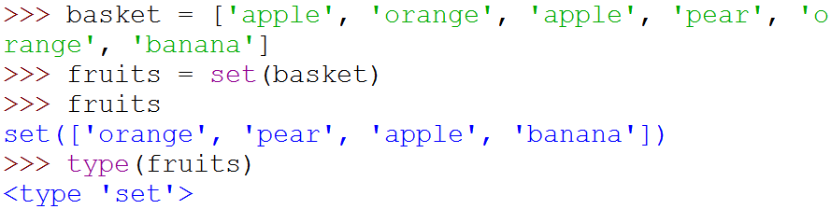
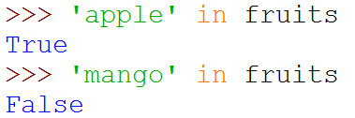
Sets
{
}
Create a set from
a sequence

Slide 19
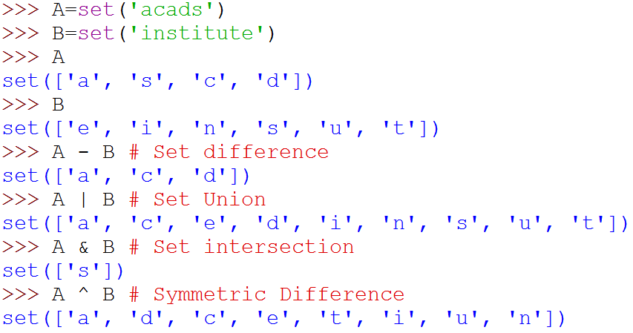
Set Operations
{
}
{
}
{
}
{
}
{
}

Slide 20
Dictionaries
Unordered set of key:value pairs,
Keys have to be unique and immutable
Key:value pairs enclosed inside curly braces {...}
Empty dictionary is created by writing {}
Dictionaries are mutable
add new key:value pairs,
change the pairing
delete a key (and associated value)

Slide 21
Operations on Dictionaries
Operation | Meaning
len(d) | Number of key:value pairs in d
d.keys() | List containing the keys in d
d.values() | List containing the values in d
k in d | True if key k is in d
d[k] | Value associated with key k in d
d.get(k, v) | If k is present in d, then d[k] else v
d[k] = v | Map the value v to key k in d (replace d[k] if present)
del d[k] | Remove key k (and associated value) from d
for k in d | Iterate over the keys in d

Slide 22
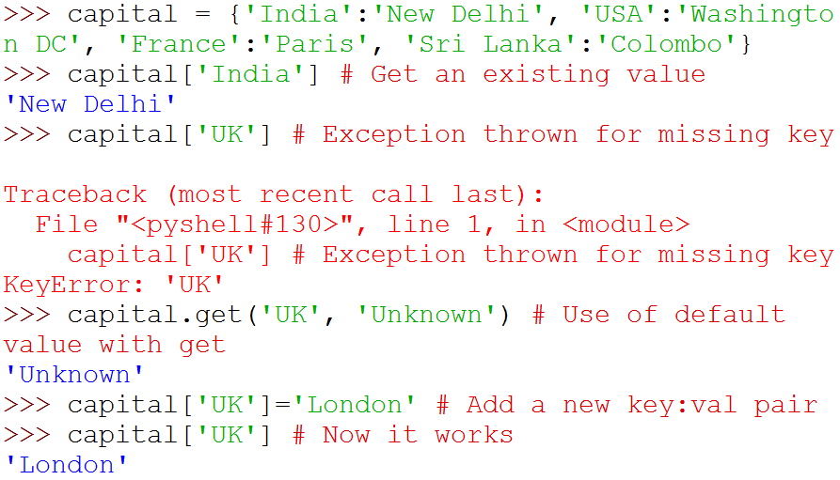
Operations on Dictionaries

Slide 23
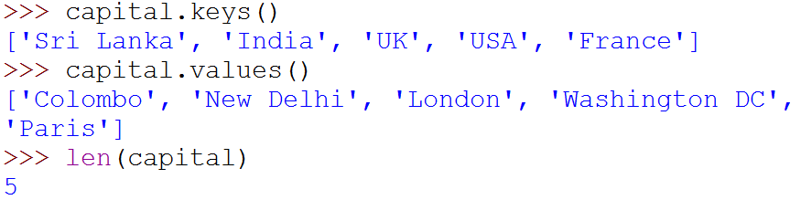
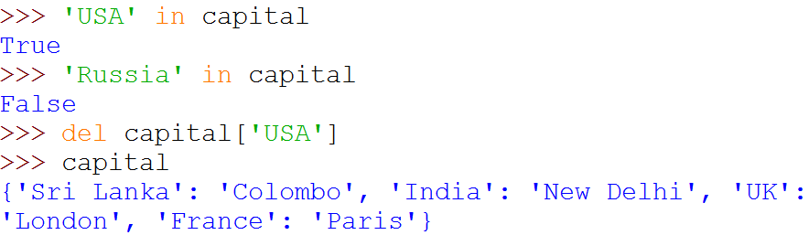
Operations on Dictionaries

Slide 24
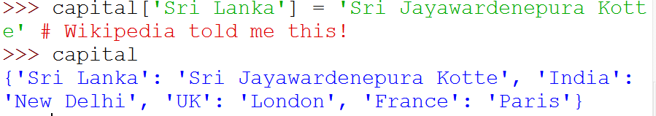
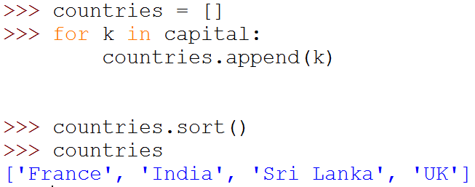
Operations on Dictionaries
# Remember: for ... in iterates over keys only
# Sort values in a list

Slide 25
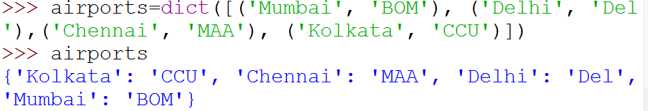
Dictionary Construction
The dict constructor: builds dictionaries directly from sequences of key-value pairs

Slide 26
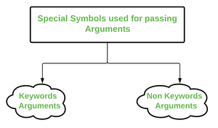
*args and **kwargs in Python
What is Python *args?
The special syntax *args in function definitions in Python is used to pass a variable number of arguments to a function. It is used to pass a non-keyworded, variable-length argument list.
The syntax is to use the symbol * to take in a variable number of arguments; by convention, it is often used with the word args.
What *args allows you to do is take in more arguments than the number of formal arguments that you previously defined. With *args, any number of extra arguments can be tacked on to your current formal parameters (including zero extra arguments).
For example, we want to make a multiply function that takes any number of arguments and is able to multiply them all together. It can be done using *args.
Using the *, the variable that we associate with the * becomes iterable meaning you can do things like iterate over it, run some higher-order functions such as map and filter, etc.

Slide 27
Example
def myFun(arg1, *argv):
print("First argument :", arg1)
for arg in argv:
print("Next argument through *argv :", arg)
myFun('Hello', 'Welcome', 'to', 'GeeksforGeeks')
Output:
First argument : Hello
Next argument through *argv : Welcome
Next argument through *argv : to
Next argument through *argv : GeeksforGeeks

Slide 28
What is Python **kwargs?
The special syntax **kwargs in function definitions in Python is used to pass a keyworded, variable-length argument list. We use the name kwargs with the double star. The reason is that the double star allows us to pass through keyword arguments (and any number of them).
A keyword argument is where you provide a name to the variable as you pass it into the function.
One can think of the kwargs as being a dictionary that maps each keyword to the value that we pass alongside it. That is why when we iterate over the kwargs there doesn’t seem to be any order in which they were printed out.

Slide 29
Example
def myFun(**kwargs):
for key, value in kwargs.items():
print("%s == %s" % (key, value))
# Driver code
myFun(first='Geeks', mid='for', last='Geeks')
Output:
first == Geeks
mid == for
last == Geeks

Slide 30

Parts of a function
Input
f
Output

Slide 31
def max (a, b):
‘’’return maximum among a and b’’’
if (a > b):
return a
else:
return b
keyword
2 arguments
a and b
(formal args)
Function Name
x = max(6, 4)
Body of thefunction,
indented w.r.t the
def keyword
Call to the function.
Actual args are 6 and 4.
Documentation comment
(docstring), type
help <function-name>
on prompt to get help for the function

Slide 32
def max (a, b):
‘‘‘return maximum among a and b’’’
if (a > b):
return a
else:
return b
In[3] : help(max)
Help on function max in module __main__:
max(a, b)
return maximum among a and b

Slide 33
Keyword Arguments
def printName(first, last, initials) :
if initials:
print (first[0] + '. ' + last[0] + '.')
else:
print (first, last)
Note use of [0] to get the first character of a string. More on this later.
Call | Output
printName('Acads', 'Institute', False) | Acads Institute
printName('Acads', 'Institute', True) | A. I.
printName(last='Institute', initials=False, first='Acads') | Acads Institute
printName('Acads', initials=True, last='Institute') | A. I.

Slide 34
Keyword Arguments
Parameter passing where formal is bound to actual using formal's name
Can mix keyword and non-keyword arguments
All non-keyword arguments precede keyword arguments in the call
Non-keyword arguments are matched by position (order is important)
Order of keyword arguments is not important

Slide 35
Default Values
def printName(first, last, initials=False) :
if initials:
print (first[0] + '. ' + last[0] + '.')
else:
print (first, last)
Note the use of “default” value
Call | Output
printName('Acads', 'Institute') | Acads Institute
printName(first='Acads', last='Institute', initials=True) | A. I.
printName(last='Institute', first='Acads') | Acads Institute
printName('Acads', last='Institute') | Acads Institute

Slide 36
Default Values
Allows user to call a function with fewer arguments
Useful when some argument has a fixed value for most of the calls
All arguments with default values must be at the end of argument list
non-default argument can not follow default argument

Slide 37
Globals
Globals allow functions to communicate with each other indirectly
Without parameter passing/return value
Convenient when two seemingly “far-apart” functions want to share data
No direct caller/callee relation
If a function has to update a global, it must re-declare the global variable with global keyword.

Slide 38
Globals
PI = 3.14
def perimeter(r):
return 2 * PI * r
def area(r):
return PI * r * r
def update_pi():
global PI
PI = 3.14159
>>> print(area (100))
31400.0
>>> print(perimeter(10))
62.800000000000004
>>> update_pi()
>>> print(area(100))
31415.999999999996
>>> print(perimeter(10))
62.832
defines PI to be of float type with value 3.14. PI can be used across functions. Any change to PI in update_pi will be visible to all due to the use of global.

Slide 39
Exceptions :
An exception is an event, which occurs during the execution of a program that disrupts the normal flow of the program's instructions. In general, when a Python script encounters a situation that it cannot cope with, it raises an exception. An exception is a Python object that represents an error.
When a Python script raises an exception, it must either handle the exception immediately otherwise it terminates and quits.
Python provides two types of exceptions i.e. 1)built-in 2)user defined

Slide 40
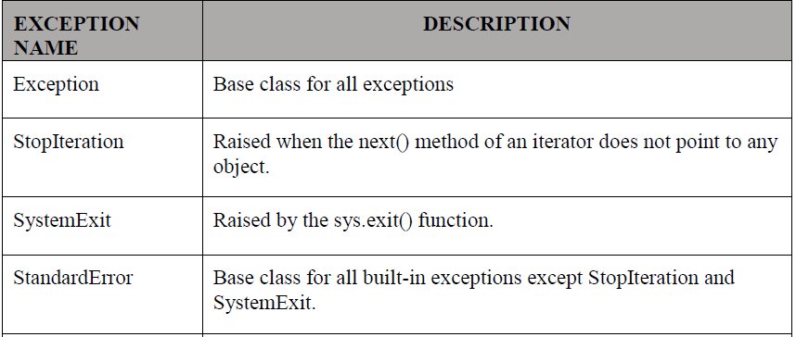
Build=in Exceptions:

Slide 41
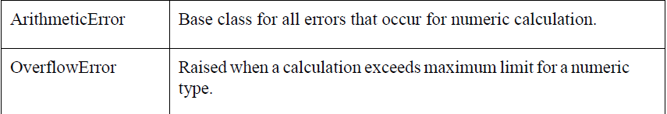
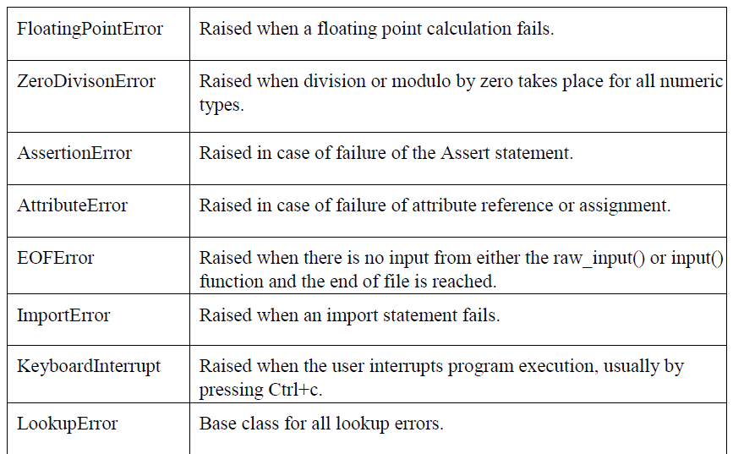

Slide 42
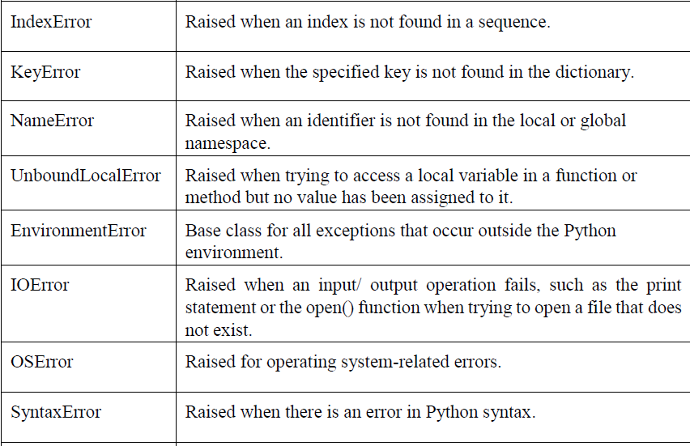

Slide 43
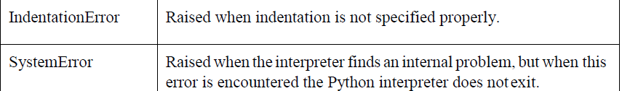
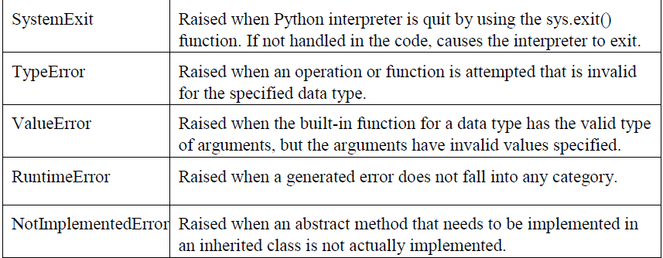

Slide 44
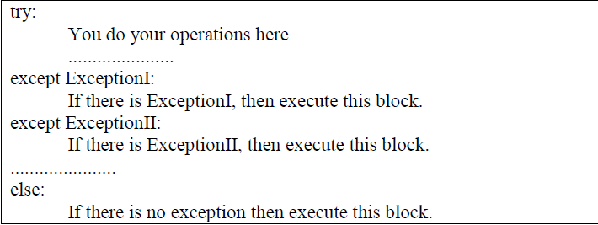
Handling Exceptions :
If you have some suspicious code that may raise an exception, you can defend your program by placing the suspicious code in a try: block. After the try: block, include an except: statement, followed by a block of code which handles the problem as elegantly as possible.
Syntax
Here is simple syntax of
try....except...else blocks-

Slide 45
Here are few important points about the above-mentioned syntax-
• A single try statement can have multiple except statements. This is useful when the try block contains statements that may throw different types of exceptions.
• You can also provide a generic except clause, which handles any exception.
• After the except clause(s), you can include an else-clause. The code in the else- block executes if the code in the try: block does not raise an exception.
• The else-block is a good place for code that does not need the try: block's protection.

Slide 46
Example:
#!/usr/bin/python3
try:
fh = open("testfile", "w")
fh.write("This is my test file for exception handling!!")
except IOError:
print ("Error: can\'t find file or read data")
else:
print ("Written content in the file successfully") fh.close()

Slide 47
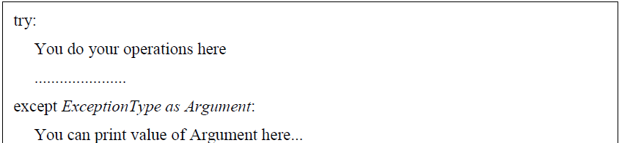
Exception with Arguments :
An exception can have an argument, which is a value that gives additional information about the problem. The contents of the argument vary by exception. You capture an exception's argument by supplying a variable in the except clause as follows-
If you write the code to handle a single exception, you can have a variable follow the name of the exception in the except statement. If you are trapping multiple exceptions, you can have a variable follow the tuple of the exception.
This variable receives the value of the exception mostly containing the cause of the exception. The variable can receive a single value or multiple values in the form of a tuple. This tuple usually contains the error string, the error number, and an errorlocation.

Slide 48
Example
Following is an example for a single exception-
#!/usr/bin/python3
# Define a function here. def temp_convert(var): try:
returnint(var)
except ValueError as Argument:
print("The argument does not contain numbers\n",Argument)
# Call above function here. temp_convert("xyz")
o/p
The argument does not contain numbers invalid literal for int() with base 10: 'xyz'

Slide 49
User-defined Exceptions :
Python also allows you to create your own exceptions byderiving classes fromthe standard built-in exceptions.
Here is an example related to RuntimeError. Here, a class is created that is subclassed from RuntimeError. This is useful when you need to display more specific information when an exception is caught.
In the try block, the user-defined exception is raised and caught in the except block. The variable e is used to create an instance of the class Networkerror.
class Networkerror(RuntimeError):
def init (self, arg):
self.args = arg
So once you have defined the above class, you can raise the exception as follows-
try:
raise Networkerror("Bad hostname")
except Networkerror,e:
print e.args

Slide 50
Anonyms function
An anonymous function in Python is a function without a name. It can be immediately invoked or stored in a variable.
Anonymous functions in Python are also known as lambda functions.
Syntax: lambda parameter(s) : expression
There are three values that define a lambda function as seen in the syntax above:
A lambda function is created using the lambda keyword.
The keyword is followed by one or many parameters.
Lastly, an expression is provided for the function. This is the part of the code that gets executed/returned.

Slide 51
Difference between Lambda & reg. Function
LAMBDA FUNCTIONS | REGULAR FUNCTIONS
Defined using the lambda keyword | Defined using the def keyword
Can be written in one line | Requires more than one line of code
No return statement required | Return statement must be defined when returning values
Can be used anonymously | Regular functions must be given a name

Slide 52
Example
1.
add_numbers = lambda a,b : a + b
print(add_numbers(2,3))
# 5
2.
numbers = [1, 3, 5, 7, 9]
double_result = map(lambda x : x+x, numbers)
print(list(double_result))
# [2, 6, 10, 14, 18]

